Slide 1

3d mini house modeling
Submitted To:
Name | ID
Md. Nur A Neouse | 193002093
Md. Jakirul Islam | 193002101
Nazifa Alam Nowrin | 193002103
Name | Designation
Mr. Abdullah Al Arif | Lecturer

Slide 2
Acknowledgment
 Firstly I owe my gratitude to Mr.Shabbir Mahmood
, my AutoCAD lecturer, who offered me invaluable knowledge and encouragement regarding this project.
 I also would like to sincerely thank my mother, who provided me with a powerful computer and encouraged me throughout the AutoCAD course.
 Furthermore, I’m greateful to websites like CADtutor, Autodesk support forums..etc that provided valuable tips about using AutoCAD.
 Finally, I’m greatful to the rest of my group member and my family, who supported me in various ways during the project period.

Slide 3
content
 ABSTRACT
 Introduction
 3D Drawing Tools
 Procedure
Editing
 Conclusion:

Slide 4
ABSTRACT
• 3D modeling is the process of developing a mathematical representation of any surface of an object in three dimensions via specialized software. The product is called a 3D model.
• Using 3D building models is extremely helpful throughout the architecture engineering and construction (AEC) lifecycle. Such models coupled with virtual walk through can enable customers to decide and be satisfied with their dream building.
With Revit software, architectural designers can now rapidly sketch out rough layouts of a floor plan, or make changes to the standard set of building designs and instantly let their customers preview their future homes

Slide 5
3D Drawing Tools
1.Extrude
2.Sweep
3.Union
4.Subtract
5.Intersect
6.Limit
7.OFFSET
8.3D POLYLINE
9.MOVE
10.PEDIT
12.PRESSUPULL

Slide 6
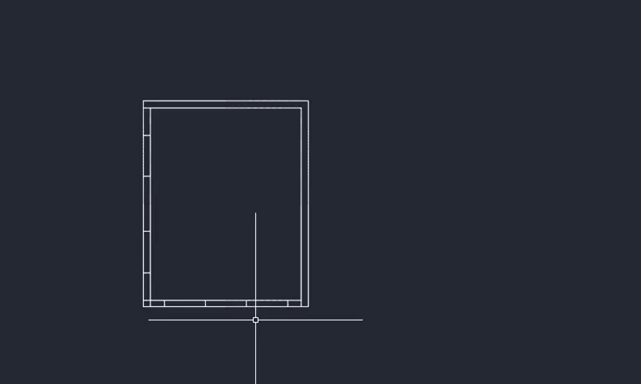
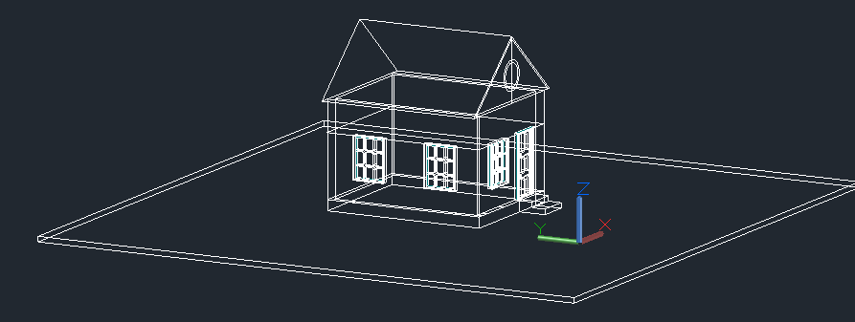
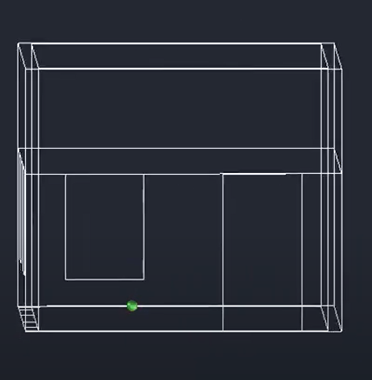
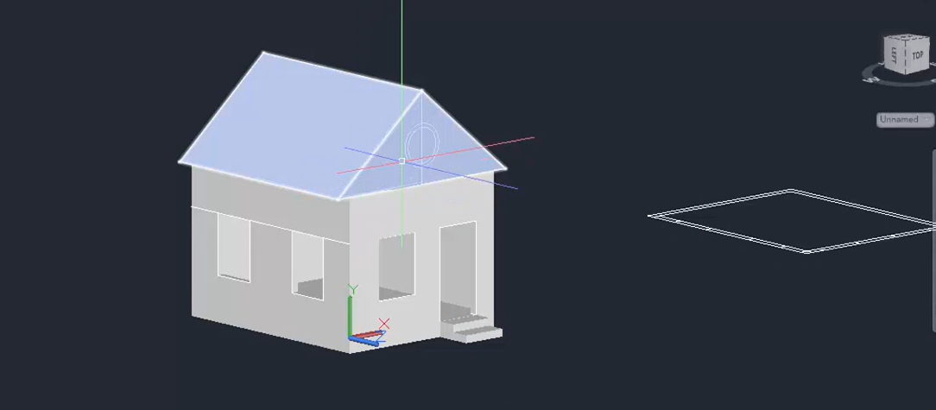
Procedure

Slide 7
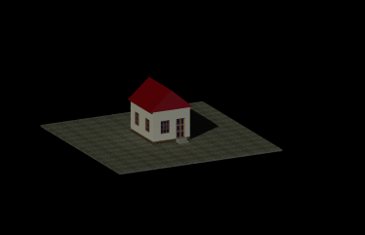
Editing

Slide 8
Conclusion
this project we'll be learning how to create 3D designs house model. the 3D modelling part of this project. We continue with some very useful add-ons that assists in the creation of walls, doors and windows. We then progress to the external environment and 3D model to complete this area. Once this area is complete we can add lighting to our scene. This is such an important aspect in architectural renders so we will use a high dynamic range image to light the scene, and give us real world lighting results. This leads us into materials and textures where you will learn to use Blenders PBR material shader to create realistic objects. This is really important skill to have when creating architectural scenes in Blender.
.

Slide 9

Question and Ans part

Slide 10


